Slide 1
Cool Projects Sharing
Yan Wu (Bella)
Major Studio 1-Section B
30 August

Slide 2
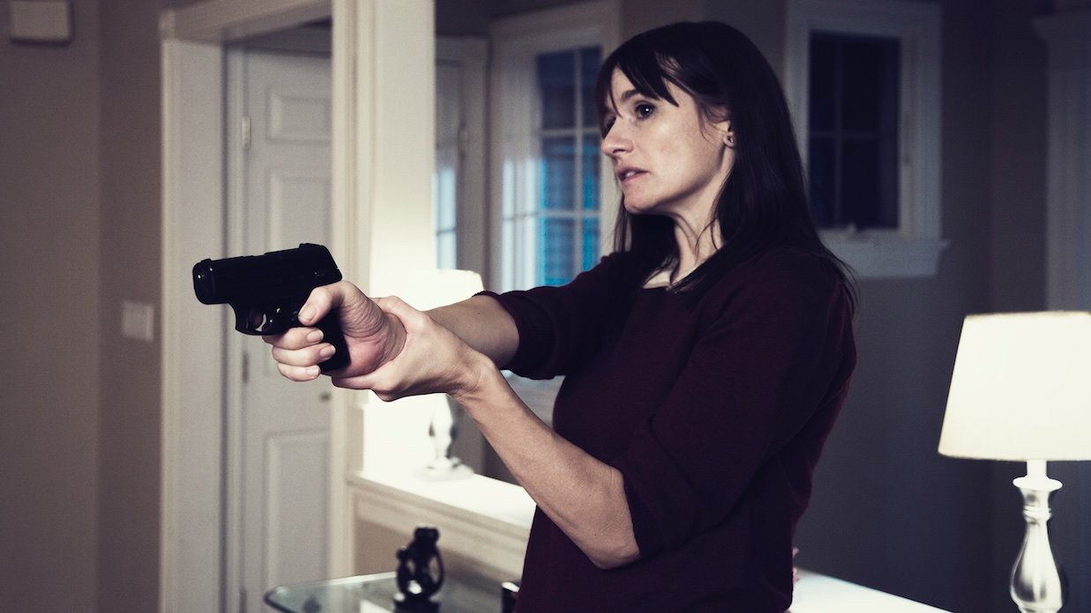
Broken Night
Interactive VR Thriller
by Eko

Slide 3


Broken Night | About Eko

Slide 4
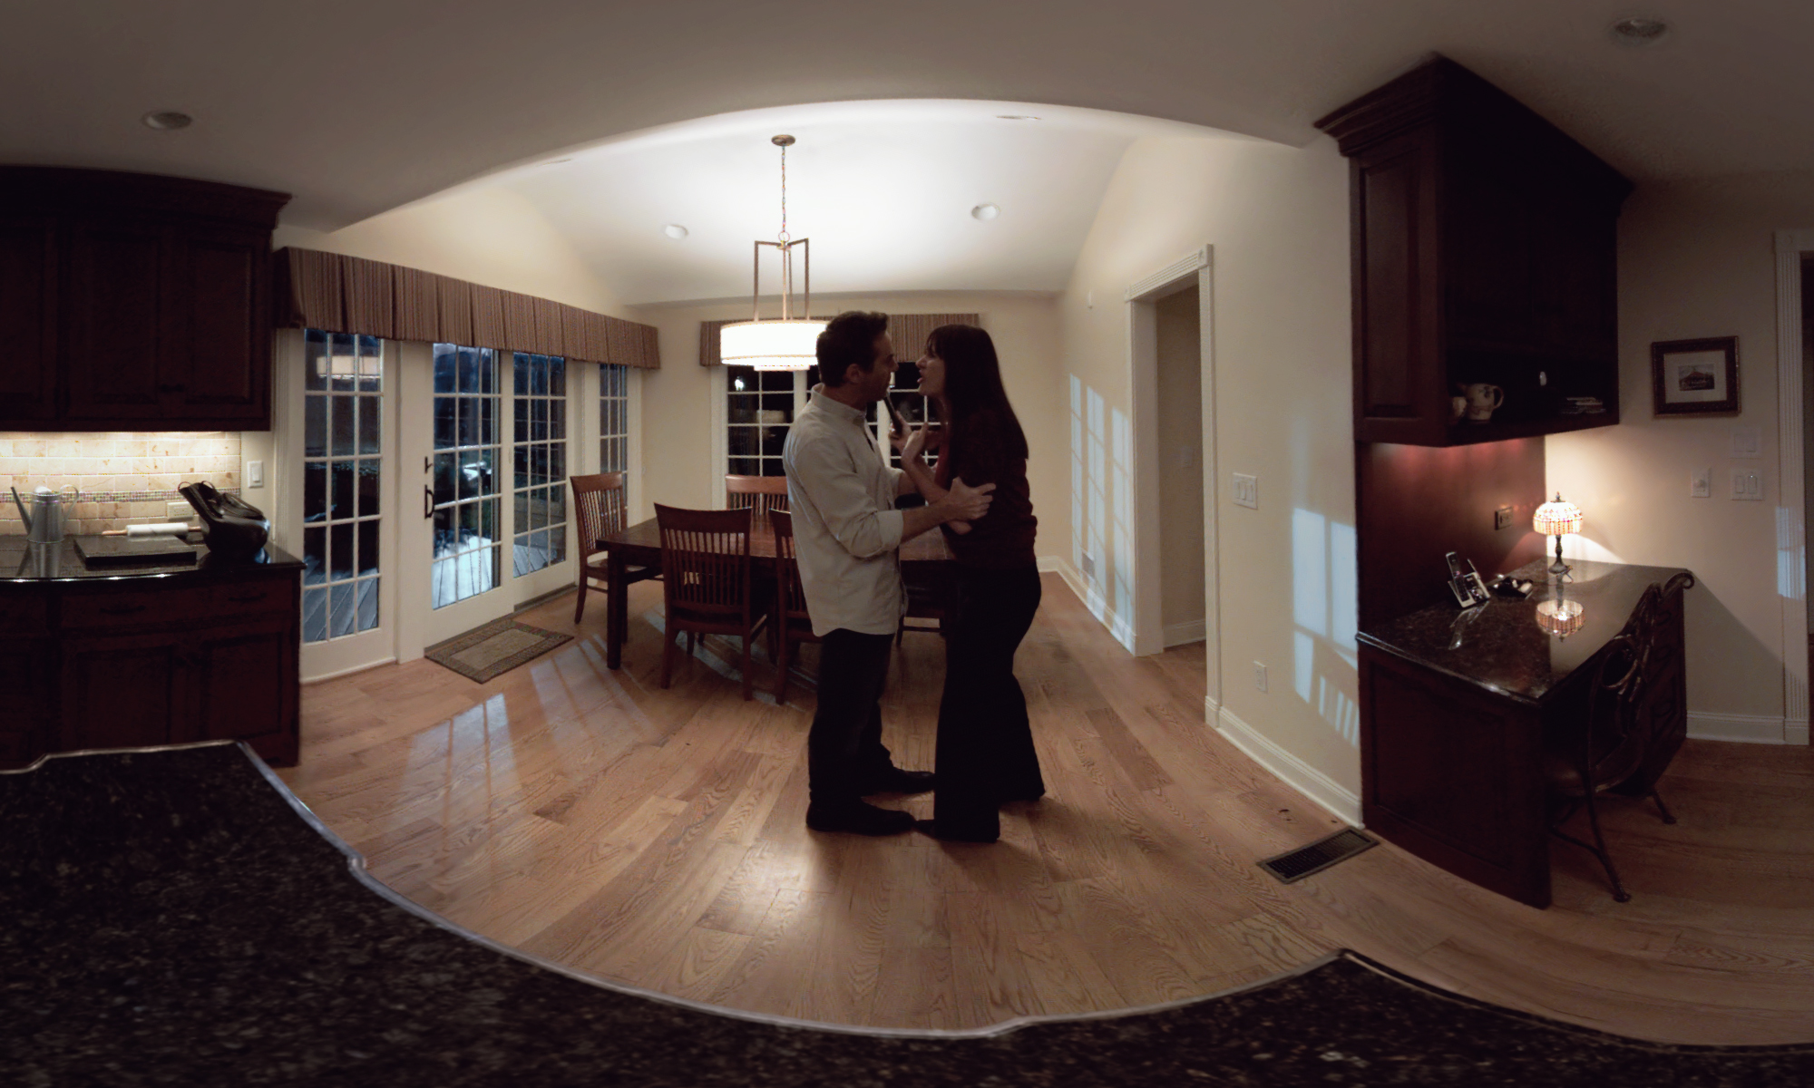
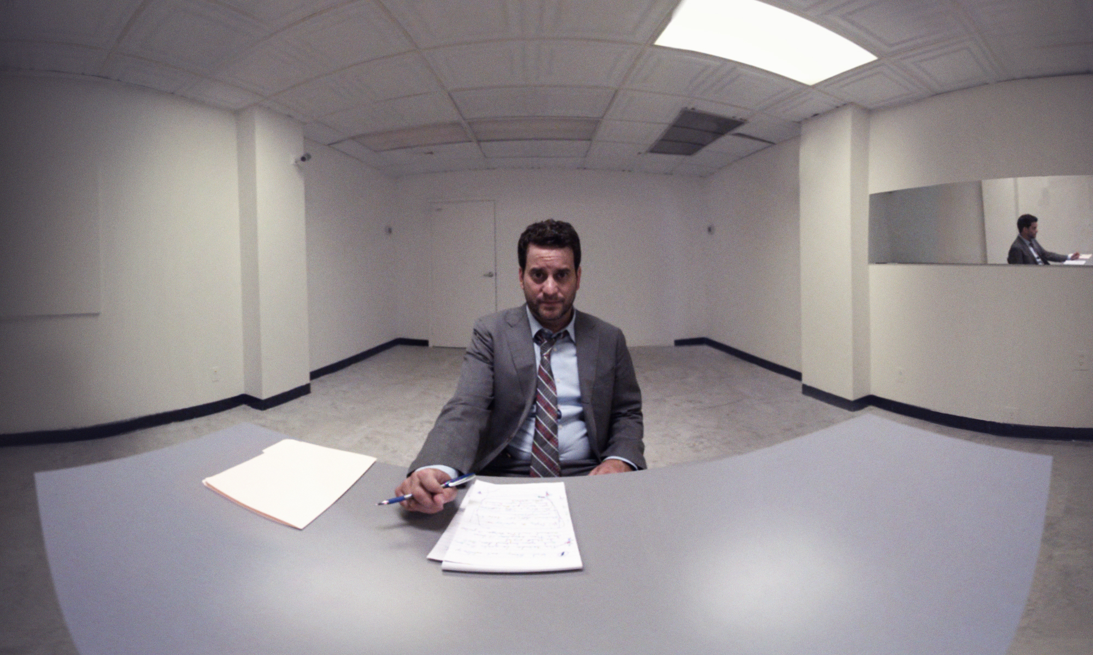
Broken Night | About Story

Slide 5
Why choose?
Why successful?
Which domains?
Interactive storytelling
Film
VR
Thriller
Immersive experience
Game-like
Entertainment
VR
Broken Night | Three Questions

Slide 6
Links
http://www.brokennightvr.com
https://company.helloeko.com/

Slide 7
Thank you!

